Slide 1
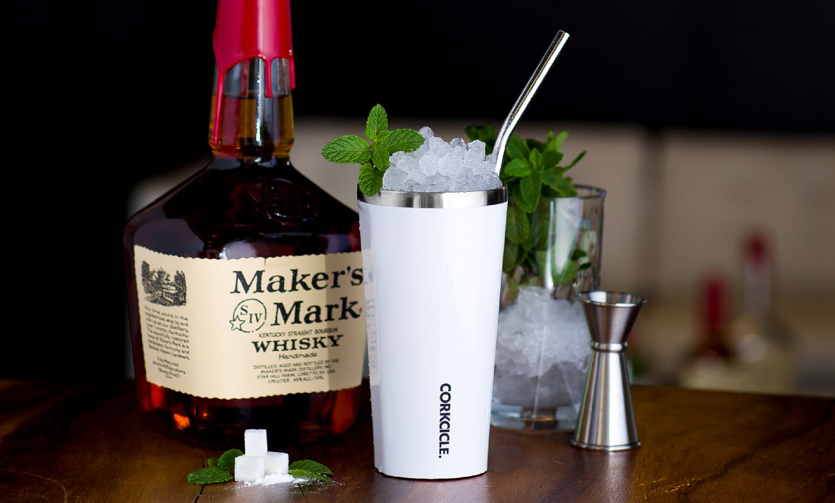
M
I
N
I
C
A
T
A
L
O
G

Slide 2
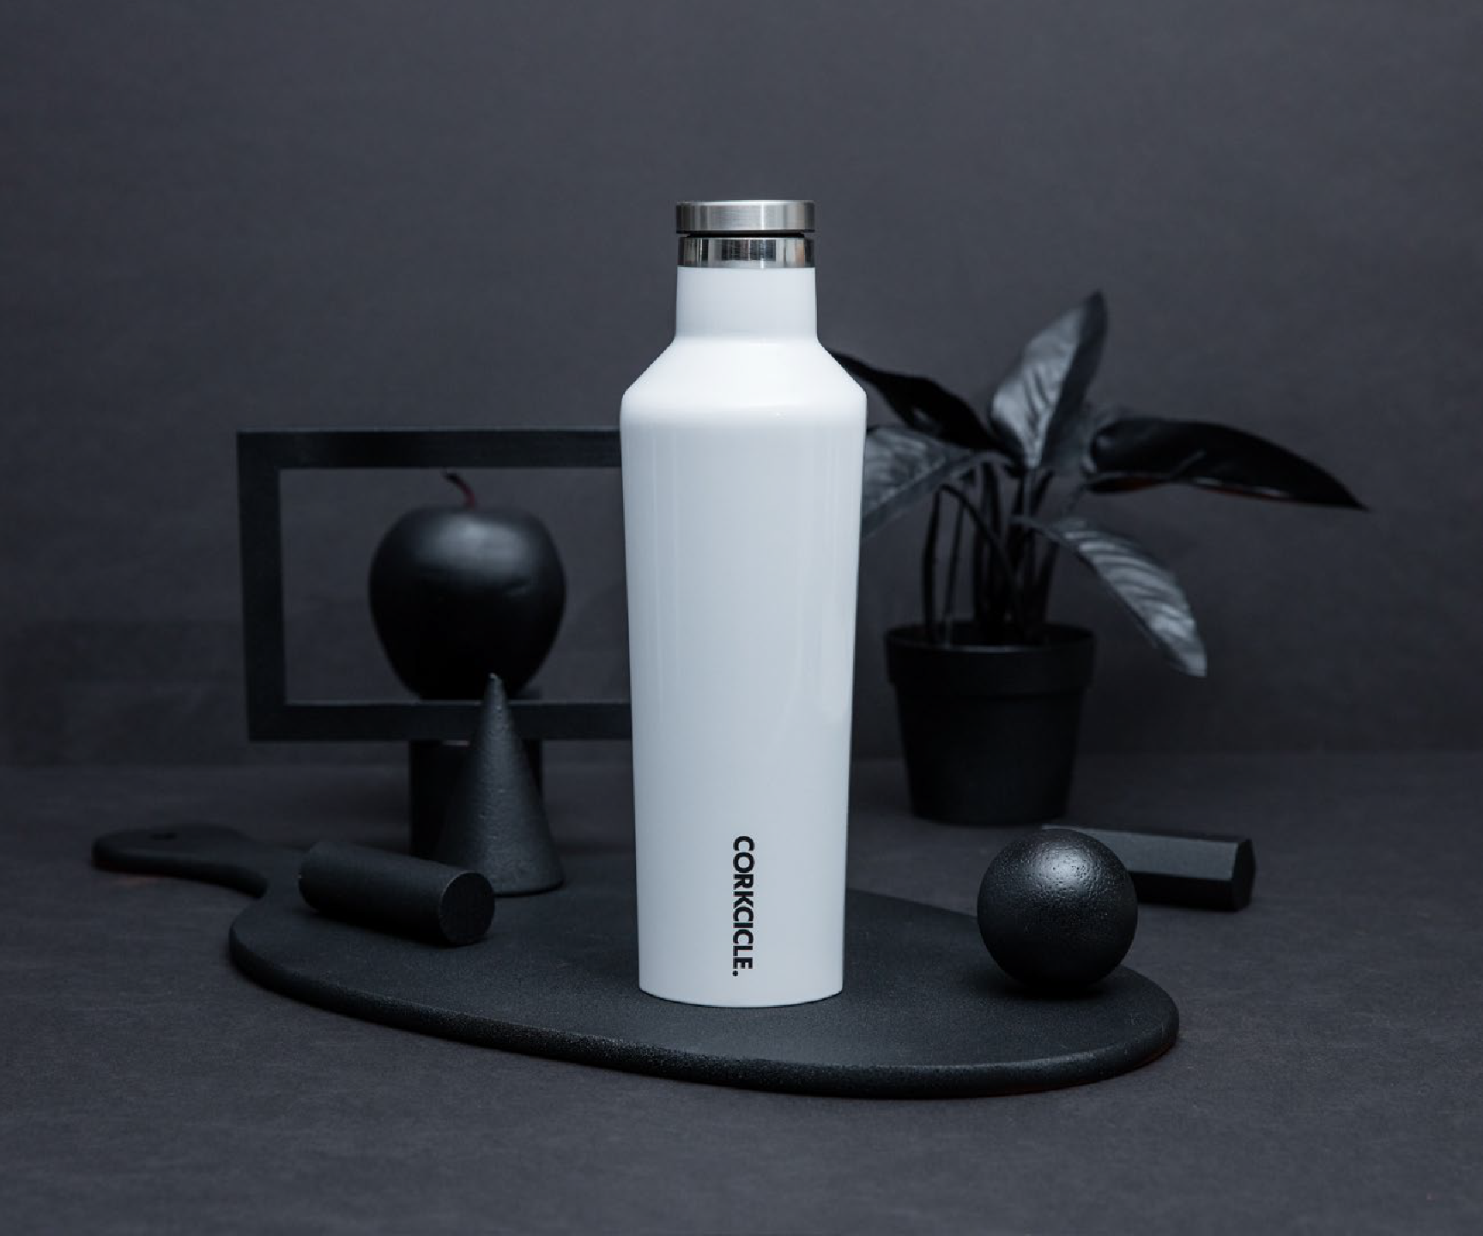
Corkcicle
Classic 16 oz Canteen
Debco | CK2016
The original, colorfully cool Corkcicle Canteen. It keeps drinks ice cold for 25 hours or warm for 12. Includes sleek, easy-to-grip flat sides, proprietary triple insulation, wide mouth to fit ice cubes, non-slip bottom and a screw-on cap. Made from 18/8 premium-grade Stainless Steel. FDA Compliant. Individually retail packaged.
Min Qty. 10 - Starting at $72.46
2

Slide 3
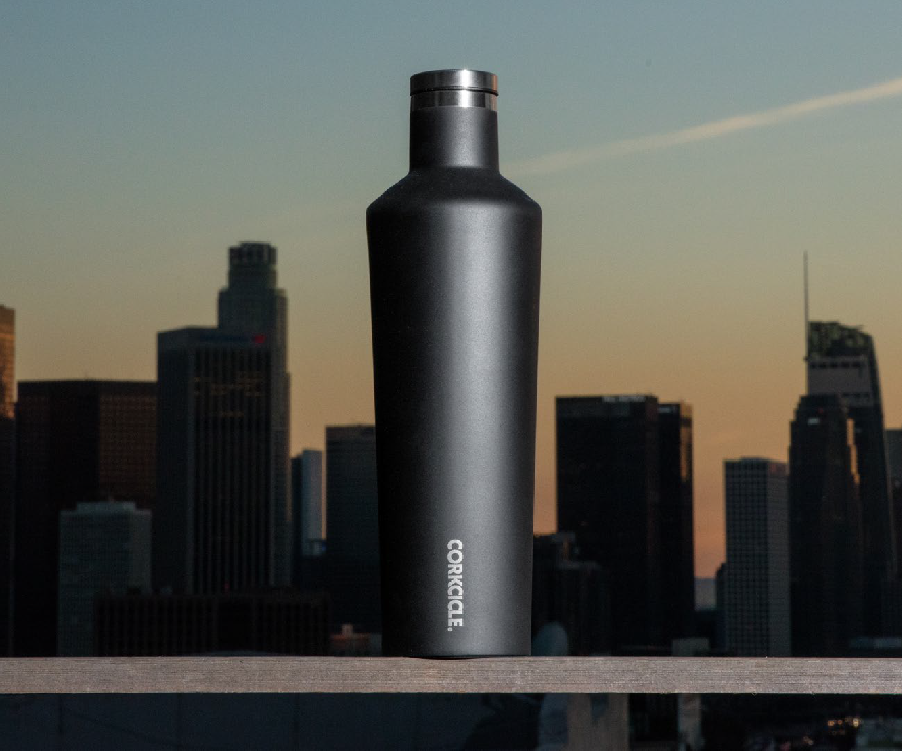
Corkcicle
Classic 25 oz Canteen
Debco | CK2025
The original, colourfully cool Corkcicle Canteen. It keeps drinks ice cold for 25 hours or warm for
12. Holds an entire bottle of wine and includes proprietary triple insulation, sleek, easy-to-grip flat sides, wide mouth to fit ice cubes, non-slip bottom and a screw-on cap. Made from 18/8 premium- grade Stainless Steel. Top rack dishwasher safe. FDA Compliant. Individually retail packaged.
Min Qty. 10 - Starting at $72.46
2

Slide 4
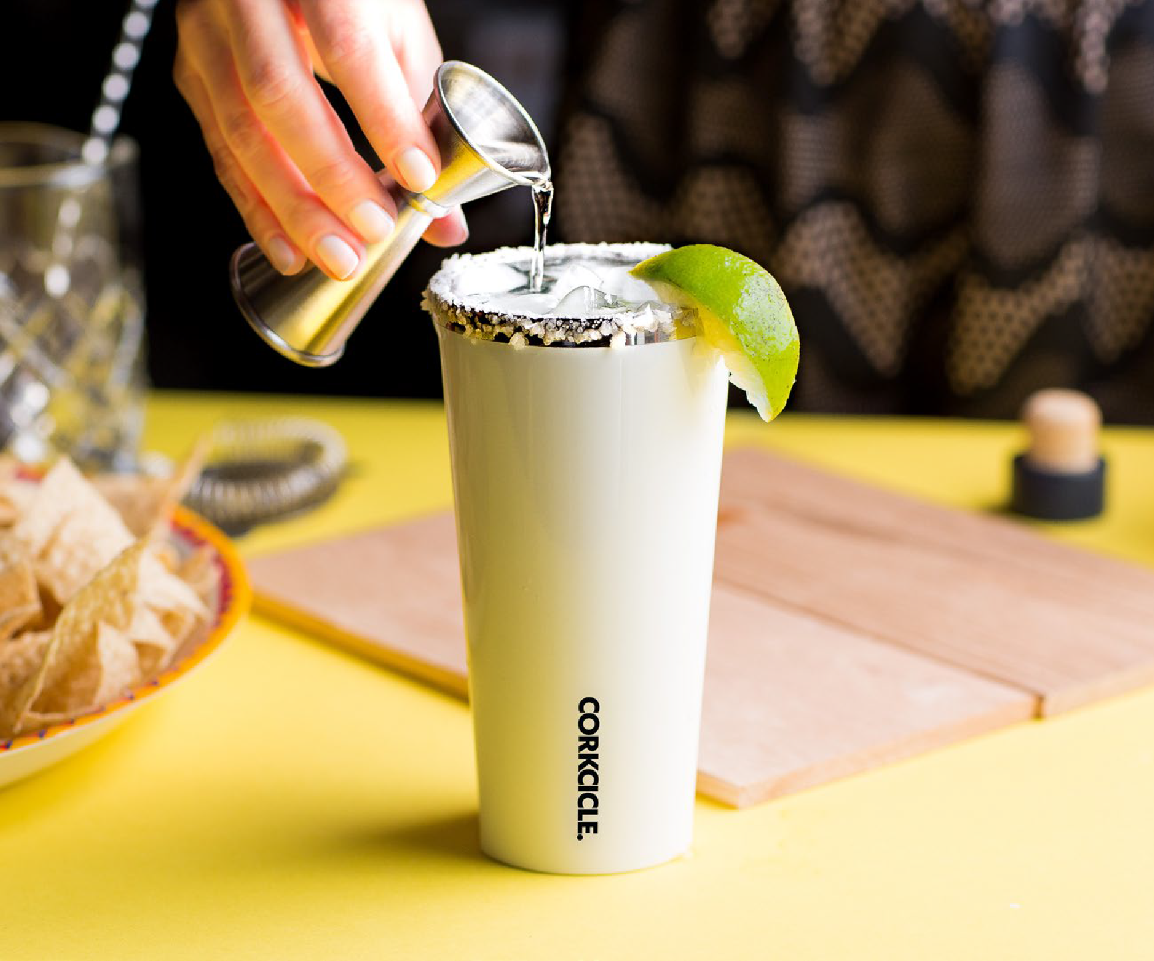
Corkcicle
Classic 16 oz. Tumbler
Debco | CK2116
Make every day refreshing with our Classic Tumbler, aka the coolest cup ever. Crafted from stainless steel with proprietary triple insulation and sleek, easy-to-grip flat sides, it keeps contents cold and refreshing for 9+ hours and hot for 3. Stays cold even longer with drinks containing ice. Plus, it comes with a sliding, shatterproof, see-through Lid.
Includes slip-proof Silicone bottom. Made from 18/8 premium-grade Stainless Steel. Lid is Tritan Plastic. BPA free and FDA Compliant. Individually retail packaged.
Min Qty. 10 - Starting at $70.86
4

Slide 5
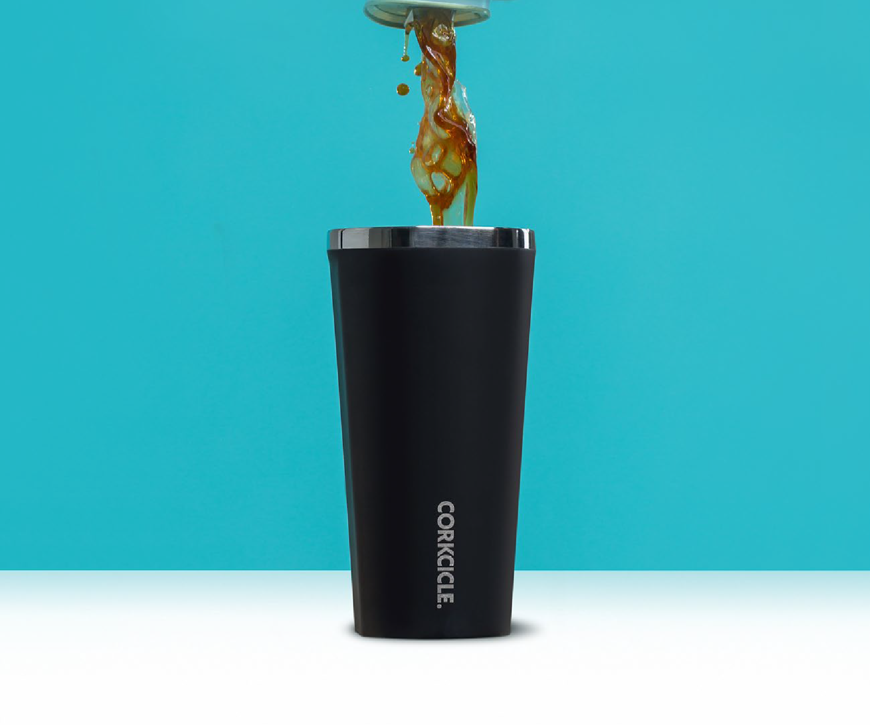
Corkcicle
Classic 24 oz. Tumbler
Debco | CK2124
Make every day refreshing with our Classic Tumbler, aka the coolest cup ever. Crafted from stainless steel with proprietary triple insulation and sleek, easy-to-grip flat sides, it keeps contents cold and refreshing for 9+ hours and hot for 3. Stays cold even longer with drinks containing ice. Plus, it comes with a sliding, shatterproof, see-through Lid. Includes slip-proof Silicone bottom and easy-grip.
Made from 18/8 premium-grade Stainless Steel. Lid is Tritan Plastic. Top rack dishwasher safe. BPA free and FDA Compliant. Individually retail packaged.
Min Qty. 10 - Starting at $70.86
4

Slide 6
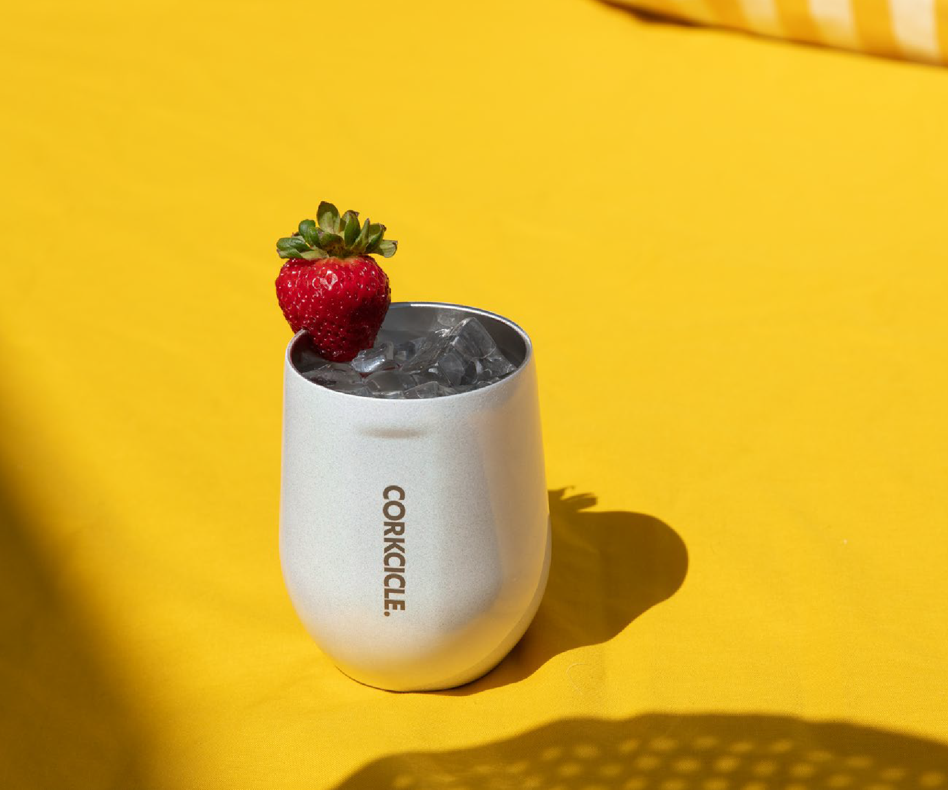
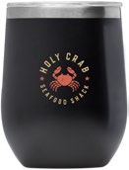
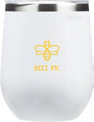
Corkcicle
Classic 12 oz. Stemless
Debco | CK2312
Lose the stem. Keep the cool. The Classic Stemless line was made with wine in mind and can be used for drinks of every kind. Stemless Wine Cup holds 12oz of your favorite beverage. Includes sliding, shatterproof lid, proprietary triple insulation for the perfect chill, slip-proof Silicone bottom and easy-grip flat sides. Keeps contents cold and refreshing for 9+ hours and hot for 3. Made from 18/8 premium-grade Stainless Steel. Lid is Tritan Plastic. Top rack dishwasher safe. BPA free and FDA Compliant. Individually retail packaged.
Min Qty. 10 - Starting at $70.86
6

Slide 7
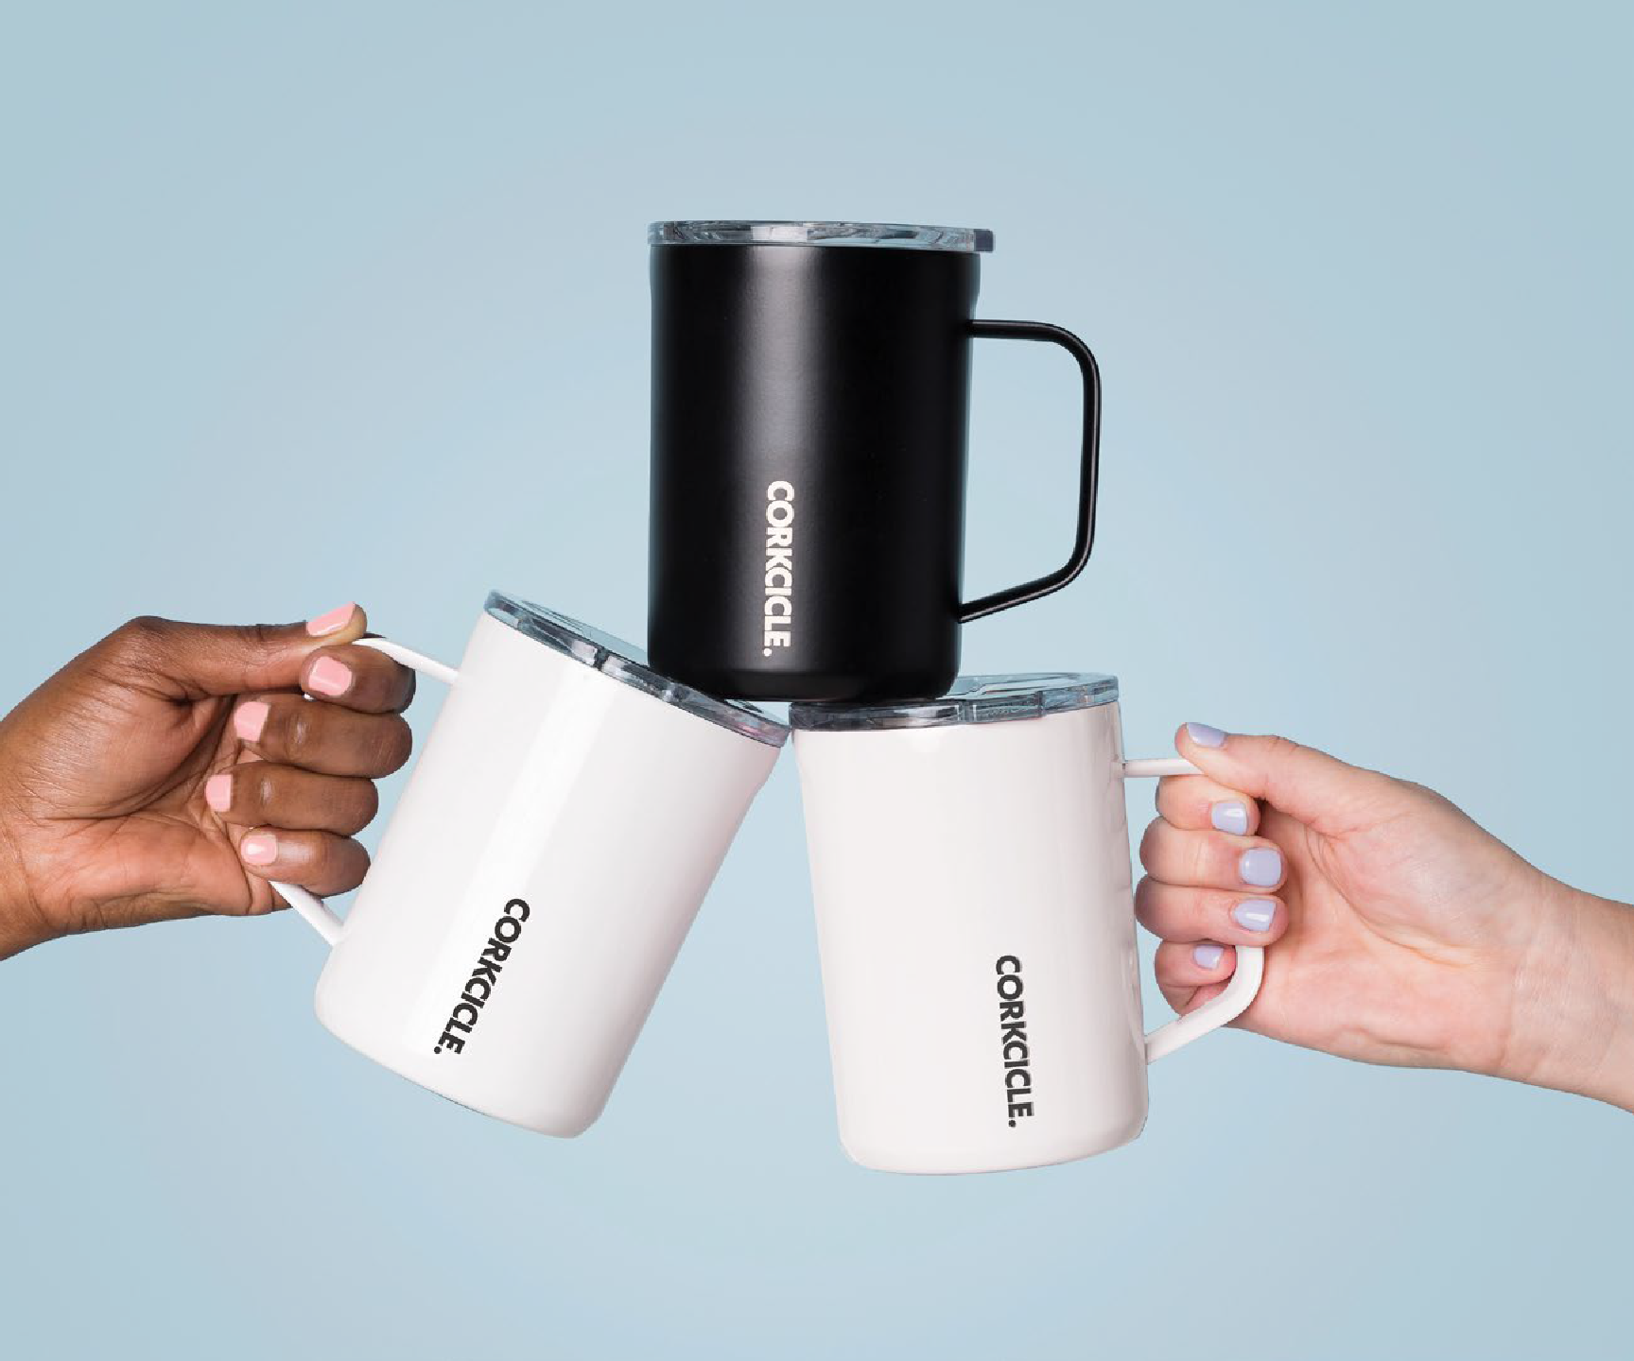
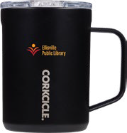
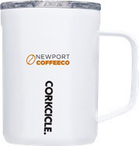
Corkcicle
16 oz. Coffee Mug
Debco | CK2516
The “morning person” of the Corkcicle lineup, Coffee Mug makes every day something to celebrate. Whether you’re caffeinating with
a hot cup of coffee or cozying up with some chamomile tea, it keeps every sip hot for up to 3 hours in style. Includes non-slip bottom,
proprietary triple insulation, sleek, easy-to-grip flat sides and a clear sliding lid. Made from 18/8 premium-grade Stainless Steel. Lid is Tritan Plastic. Top rack dishwasher safe. BPA free and FDA Compliant. Individually retail packaged.
Min Qty. 10 - Starting at $70.86
6

Slide 8
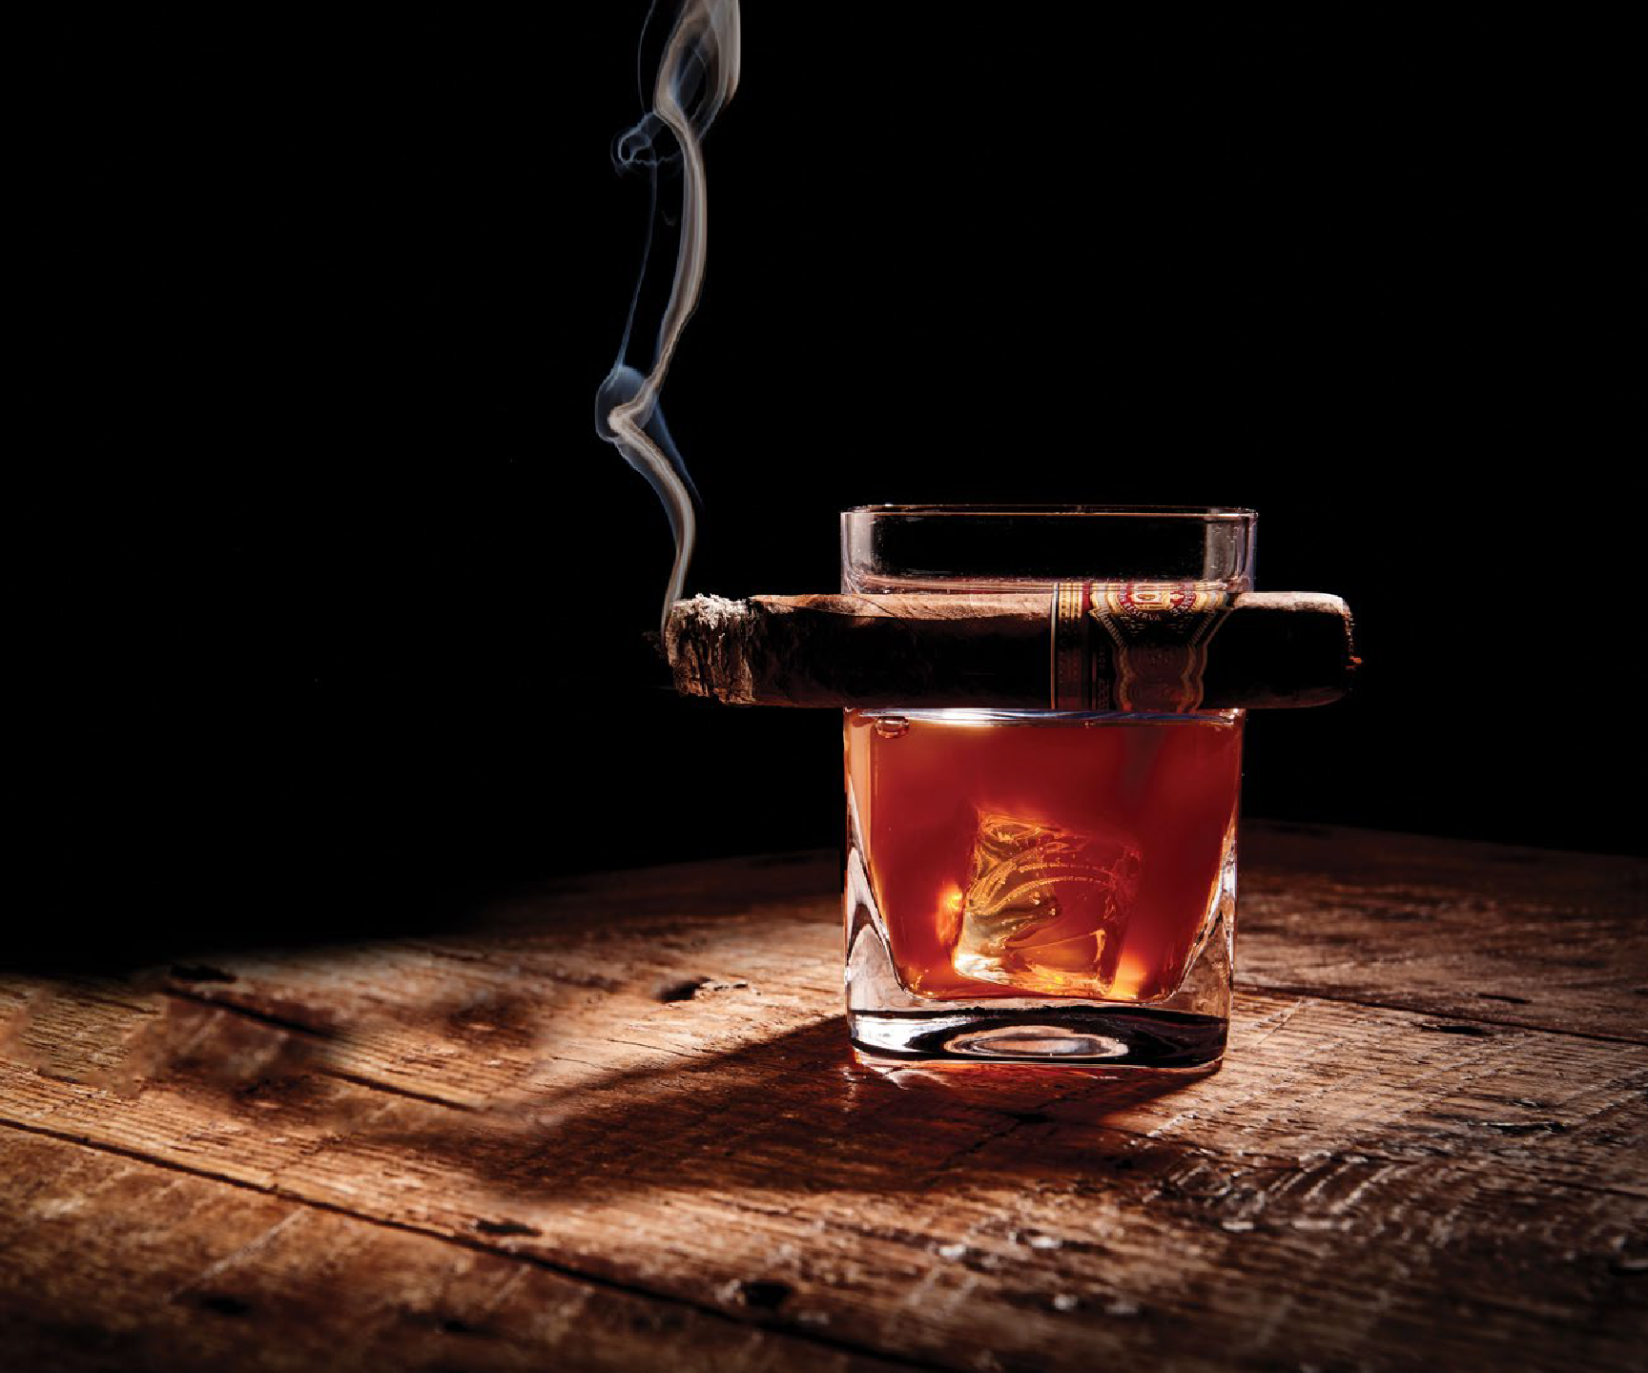
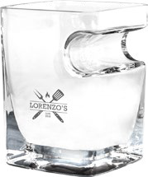
Corkcicle Cigar Glass
Debco | CK7101
Part rocks glass, part cigar rest, Cigar Glass lets you hold your drink and cigar in the same hand at the same time without all the awkward finger fumbling. So you’re free to sip and puff at your leisure. Holds up to 9oz. of liquid and various cigar sizes. Includes ergonomic built-in cigar rest in the double old fashioned whiskey glass. Handmade with care. FDA Compliant.
Individually retail packaged. Cigar not included.
Min Qty. 10 - Starting at $60.30

Slide 9
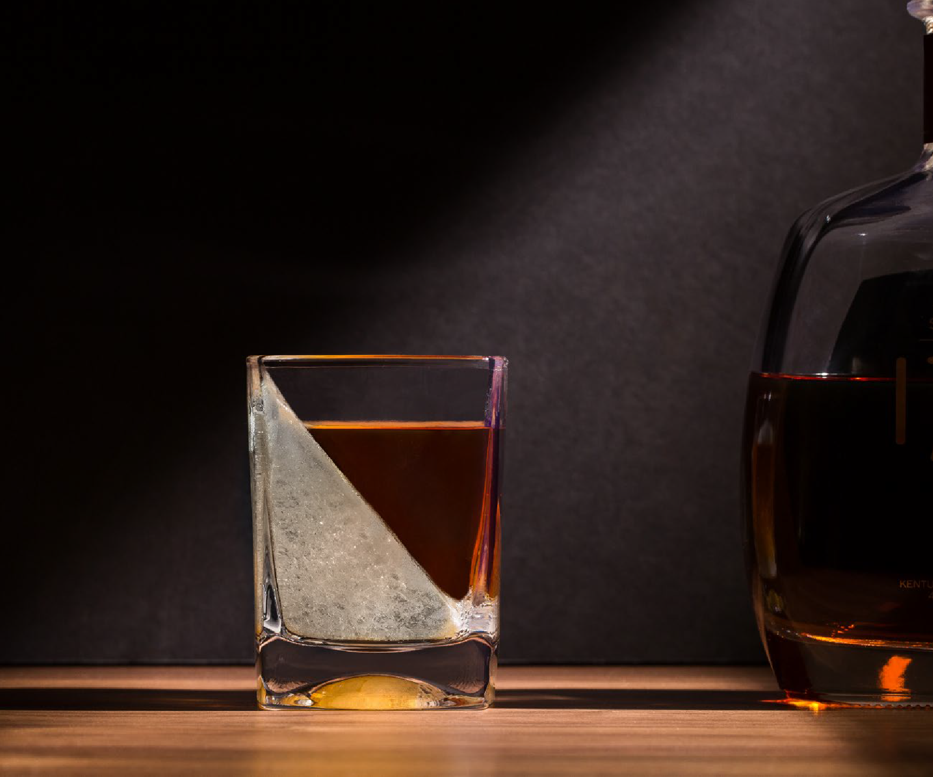
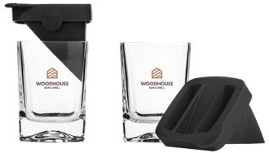
Corkcicle Whiskey Wedge
Debco | CK7001
Whiskey Wedge is the artful way to perfectly chill your favorite spirits. It’s the ideal whiskey glass for anyone who enjoys smooth sipping. During freezing, the ice forms a wedge shape on one side of the glass. When you pour a drink, the wedge melts slowly to help retain your drink’s full flavor. Makes a great gift for dad or for the barware enthusiast in your life. Includes 1 Glass + 1 Silicone Ice Form. Large format ice, double old fashioned whiskey glass with freezer
strength glass. FDA Compliant. Individually retail packaged.
Min Qty. 10 - Starting at $60.30

Slide 10
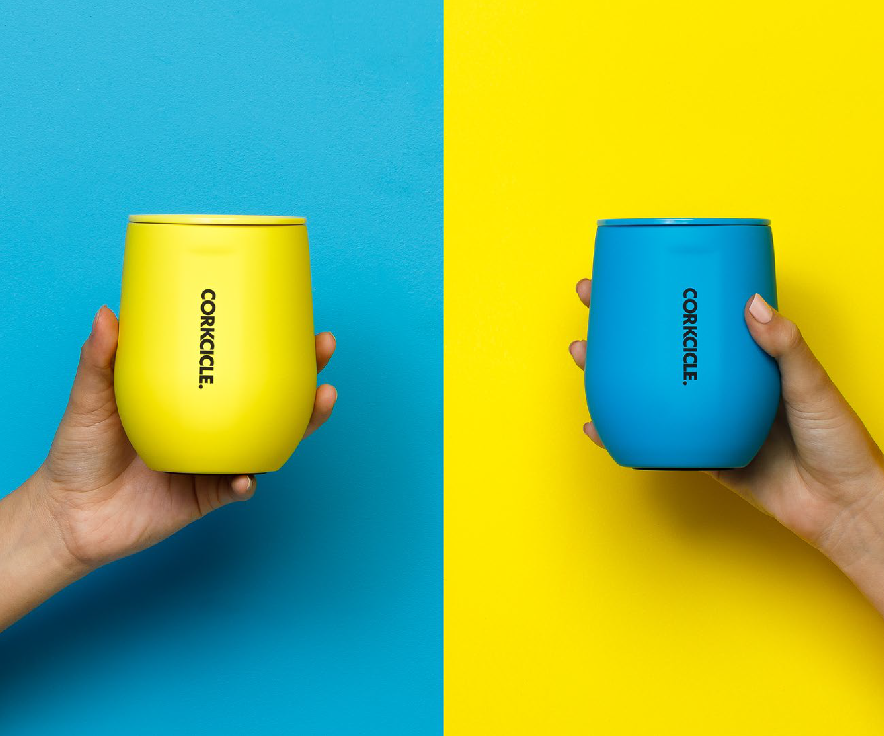
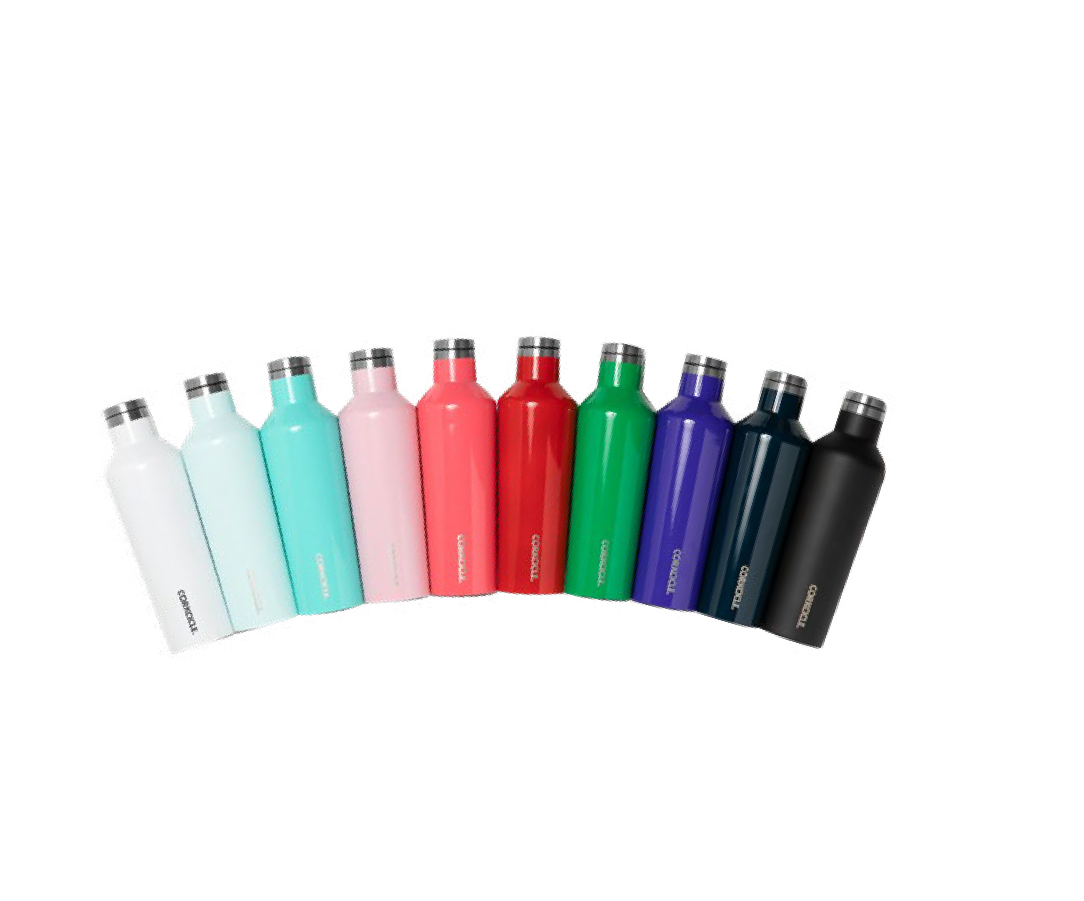
Looking For Something Different?
Love Corkcicle? Is your client looking for something a little different? We have access to a variety of different colours and styles above and beyond what we carry on our website. Talk to your account manager or sales rep to get
a custom quote on your customer’s favourite Corkcicle drinkware.
10

